Slide 1

Be Intentional
Ecclesiastes
Dr. Rick Griffith • Crossroads International Church Singapore
CICFamily.com • BibleStudyDownloads.org

Slide 2
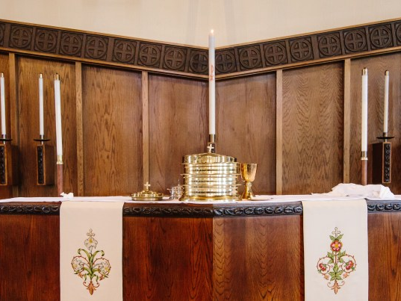
Many people think being a Christian is the most boring life possible.
Notes:
They say, "All Christians do is go to church, read an outdated dusty Book and say no to anything fun."
Many people actually feel sorry for you if you are a Christian!

Slide 3

Can Christians be happy?
Notes:
One writer notes, "Is the Christian life supposed to be boring? Not when it is lived correctly. Jesus said, "I have come that they may have life, and have it to the full" (John 10:10 NIV). There are pitfalls, and things are not always rosy. Spiritual attack is a very real thing; Christians experience depression and sorrow and misery, just like other people. But when a Christian is living in truth, and seeking the Kingdom of God and the salvation of souls, boring is the very last thing his or her life will be" (https://www.compellingtruth.org/Christian-boring.html).

Slide 4
Do you think these contradict?
enjoy life
fear God
Notes:
Can someone both love life and love God?
Do we have to choose between fun and obedience?

Slide 5


Ecclesiastes
A King's Ambition
A UNIQUE AUTHOR
Notes:
It is helpful to hear from someone who has “done it all”–especially when God inspires his words!
__________
http://churchsermonseriesideas.com/?s=ecclesiastes image

Slide 6
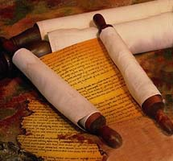
Date: Solomon in His Books
404
of Solomon
Song
Proverbs
Ecclesiastes
Solomon, as seen in –
• Song of Solomon - the lover (in his youth)
• Proverbs - the wise (in mid-life)
• Ecclesiastes - the foolish (in old age)
Notes:
Of course, I am talking about King Solomon.
Most see Solomon as having written Song of Songs first in his young life and then Proverbs in mid-life.
Now, as an old man who has “seen it all,” he muses on the meaning of life in Ecclesiastes.

Slide 7


Who do you admire?
MODERN IDOLS
Notes:
In our age people idolize athletes or attractive people who pretend to be someone else (=Hollywood and Bollywood).

Slide 8
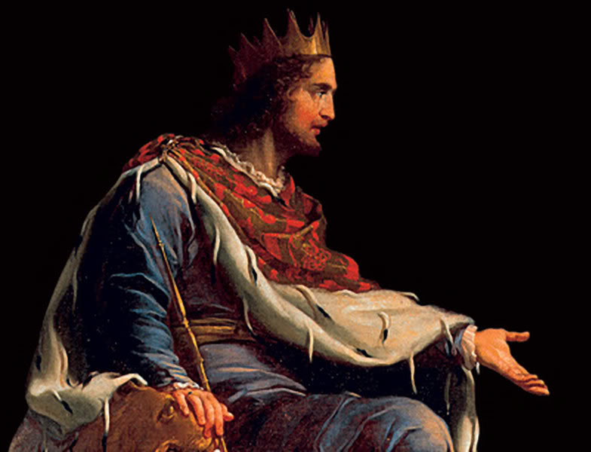
They admired sages
Notes:
But at the time of Solomon, sages were idolized and taught wisdom as the people then seemed to pursue wisdom more than they do today.

Slide 9
How can we do both?
4 ways to be intentional
enjoy life
fear God
Notes:
But back to our question: How can we be intentional to enjoy life and fear God?
These are NOT mutually exclusive! You CAN do both and SHOULD do both!
The Bible presents both the ideals of life and also the realities. Proverbs gives the ideals and Ecclesiastes gives the exceptions to those ideals.
Many of us think that we cannot both enjoy life and fear God in the midst of the uncertainties and fleeting nature of life. Solomon shows us that actually all of these work fine together—since life is short and perplexing, we can and should both enjoy life and fear God. In fact, the very fear of God is what makes us best enjoy life!
Today we will see 4 ways to be intentional to do both.
Here's the first way to be intentional to enjoy life and fear God. It’s to…

Slide 10

I. Live as if life is fleeting
(1:1-11).
Notes:
Even the oldest people don't live very long.
Life's short-lived and fleeting cycles should move us to seek God.

Slide 11
Ecclesiastes Overview
403

Slide 12
Slides on
Ecclesiastes 1

Slide 13

Going in Circles (1:1-11)
Ecclesiastes
Dr. Rick Griffith • Crossroads International Church Singapore
CICFamily.com • BibleStudyDownloads.org

Slide 14

Why so fast?

Slide 15

Rats often run in circles

Slide 16

Rats climb the ladder

Slide 17
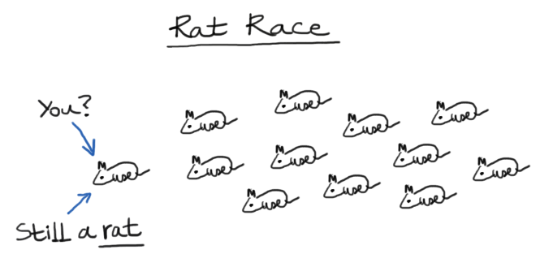
Still a rat
Rat Race
You?
Still a rat.

Slide 18

"Yeah, but if only you knew my boss…"

Slide 19


Every human endeavor is short-lived (1:2).

Slide 20

1:2 KJV
The Hebrew Word Hebel
“Vanity of vanities!”
“all is vanity!”

Slide 21


Meaning of Hebel
lbh
"vanity" (KJV, ESV, NAU),
"meaningless" (NIV, NLT),
"futile" (NET, TLB, BKC)
"fleeting"
The Key Word of Ecclesiastes

Slide 22

Two Ways to Look at Life
"enjoy life"
406
"fear God"
"keep his commandments"
"meaningless"
"under the sun"
Notes:
I used to see this book as if Solomon is under water most of the time, declaring life to be "meaningless." Why? He is seeing life only "under the sun" in a horizontal perspective. It's the human view.
However, at various points he "comes up for air" only to advise his readers to "enjoy life" (2:24a; 12:13a, etc.) and to "fear God" (2:24b-26). The conclusion also tells us to "keep his commandments" (12:13b).
But is this the right way to look at the book?

Slide 23

The Meaninglessness of Human Achievement & Wisdom
Ecclesiastes
But…
Is life really meaningless?
Was Solomon schizo?

Slide 24

Hebel literally means
"a breath, wind, or vapor"
(Prov. 21:6; Isa. 57:13).
Ecclesiastes

Slide 25

A Very Literal Translation
Metaphor:
what doesn’t last —"what is without real substance, value, permanence, significance, or meaning" (BKC, 1:976)

Slide 26
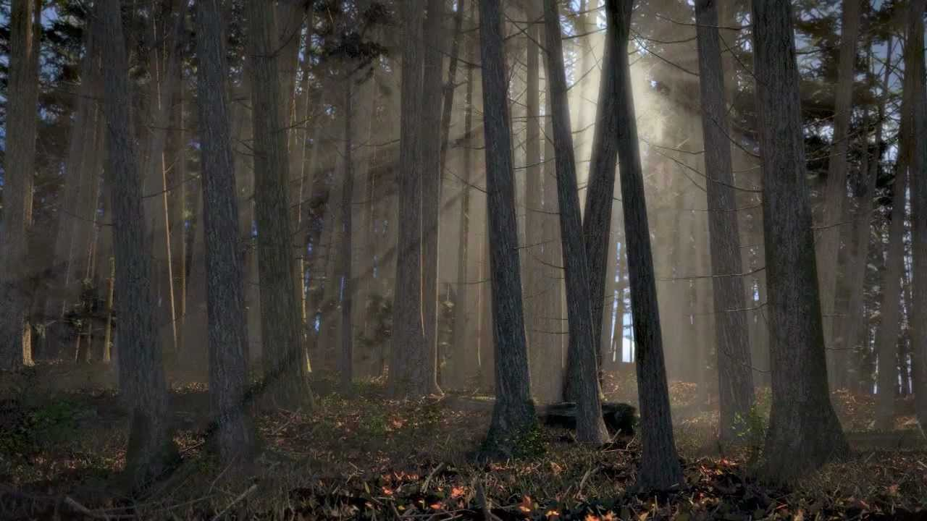
fleeting or transitory (6:12 with 3:19; 7:15; 9:9; 11:10)
What's wind or vapor like?
enigmatic or perplexing (6:2; 8:10, 14)
unseen and obscure (11:8).
BKC, 1:976

Slide 27

Fleeting
Passing
Brief
Temporary
Momentary
Transitory
Short-lived
Synonyms:

Slide 28
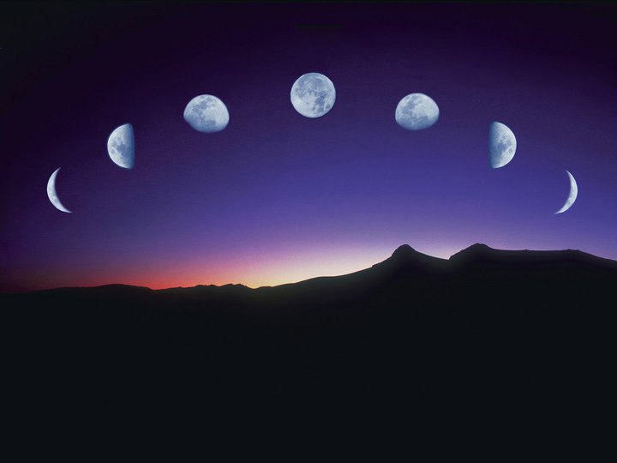
Life's many cycles are passing (1:3-11).
Ecclesiastes

Slide 29

Theme (of 1:1–6:9): Our work ultimately brings us nowhere (1:3).
"What do people get for all their hard work
under the sun?" (NLT)

Slide 30

Proof: Life's many fleeting repetitions bring no real change (1:4-11).

Slide 31
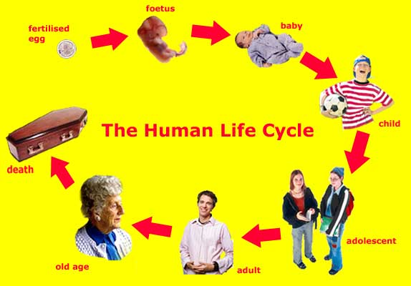
The Human Life Cycle
fetus
fertilized egg
baby
Ecclesiastes
Ceaseless cycles are evident in our generations (1:4).
child
death
Adolescent
old age
adult

Slide 32

Ceaseless cycles are evident in nature (1:5-7).

Slide 33

The sun continually rises and sets (1:5).

Slide 34

The wind blows in circles (1:6).

Slide 35
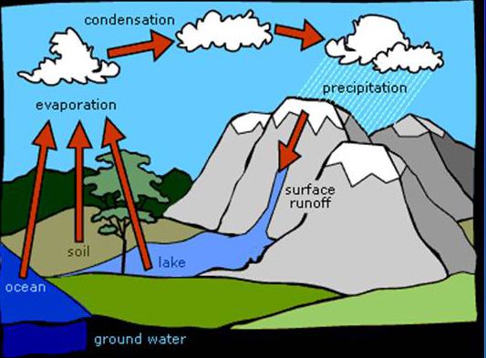

The Water Cycle
condensation
precipitation
evaporation
surface
runoff
soil
lake
ocean
The rivers and seas cycle water endlessly (1:7).
Ecclesiastes
Notes:
http://churchsermonseriesideas.com/?s=ecclesiastes image

Slide 36
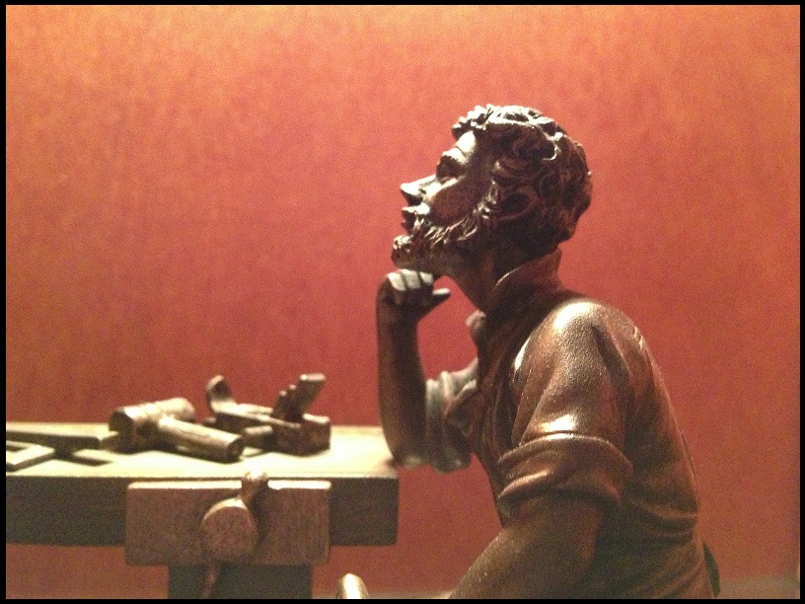
"Nothing under the sun is truly new" (1:9b)
Ceaseless cycles are evident in history (1:8-11)

Slide 37

Life's short-lived and fleeting cycles should move us to seek God.
Main Idea of 1:1-11

Slide 38

Don't get caught up in the race

Slide 39

Rats often run in circles
Ecclesiastes

Slide 40
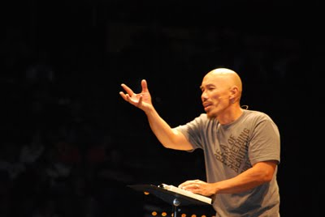
Don't succeed at the wrong thing
"Our greatest fear should not be failure, but succeeding in the things in life that really don’t matter."
–Francis Chan

Slide 41
How can we do both?
enjoy life
fear God
Notes:
How can we be intentional to enjoy life and fear God?

Slide 42
I. Live as if life is fleeting
(1:1-11).
Notes:
Even the oldest people don't live very long.
Life's short-lived and fleeting cycles should move us to seek God.

Slide 43

II. Live as if work is fleeting
(1:12–6:9).
Notes:
Every human endeavor doesn't last very long.

Slide 44
Ecclesiastes Overview
403
Notes:
But now the subject shifts into the second fleeting area in the book.

Slide 45
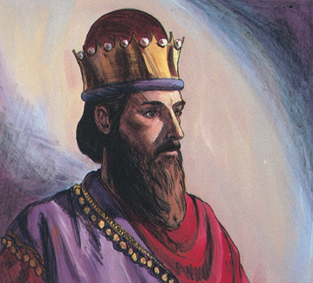
Profitless Pursuits
Ecclesiastes 1:12–2:11
Dr. Rick Griffith • Crossroads International Church Singapore
CICFamily.com • BibleStudyDownloads.org

Slide 46
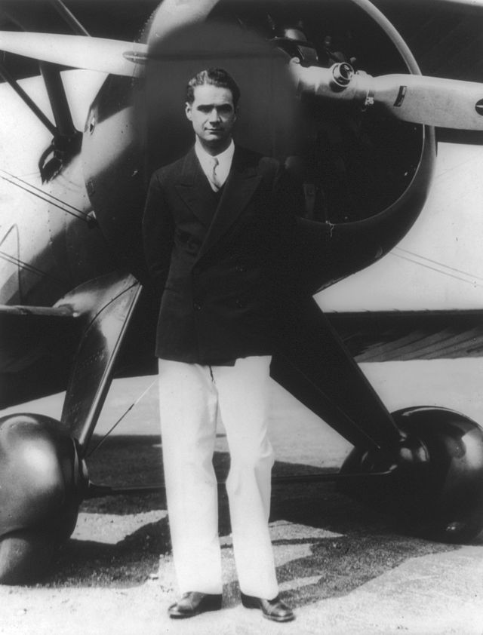
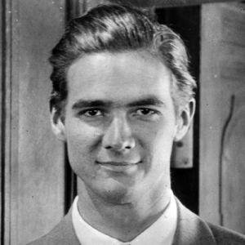
Howard Hughes (1905-1976)
Notes:
Howard Hughes, Jr. (December 24, 1905 – April 5, 1976) was an American businessman, investor, aviator, aerospace engineer, film maker and philanthropist. He was one of the wealthiest people in the world.

Slide 47

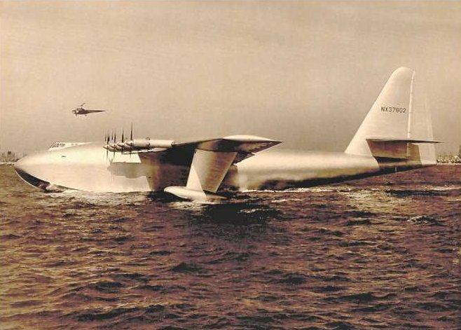
H-4 Hercules 2
Notes:
He is best known for his interest in aviation, having founded Hughes Aircraft. This company sought to help the WWII effort by making the largest plane in history designed to transport 700 troops across the Atlantic.

Slide 48
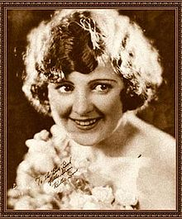
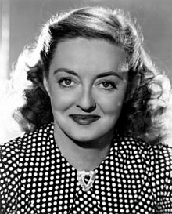
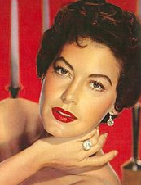
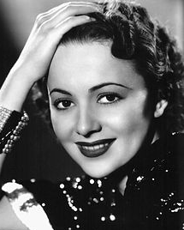
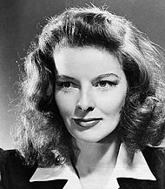

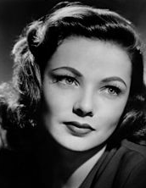

Women, Women, Women!
Billie Dove
Bette Davis
Ava Gardner
Olivia de Havilland
Katharine Hepburn
Gene Tierney
Joan Fontaine
Ginger Rogers
Notes:
"Hughes dated many famous women, including Billie Dove, Bette Davis, Ava Gardner, Olivia de Havilland, Katharine Hepburn, Ginger Rogers and Gene Tierney. He also proposed to Joan Fontaine several times" (wikipedia).

Slide 49
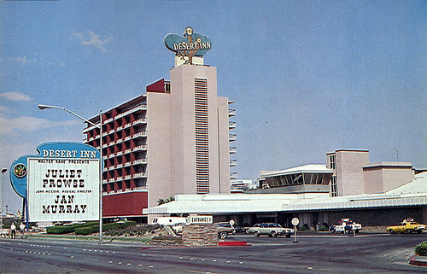
The Desert Inn, Las Vegas
Notes:
His obsessive compulsive behavior especially plagued Hughes in his later years. "On November 24, 1966 (Thanksgiving Day), Hughes arrived in Las Vegas by railroad car and moved into the Desert Inn. Because he refused to leave the hotel, and to avoid further conflicts with the owners, Hughes bought the Desert Inn in early 1967" (Wikipedia).

Slide 50
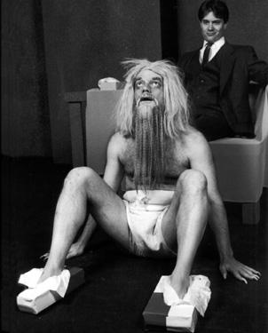
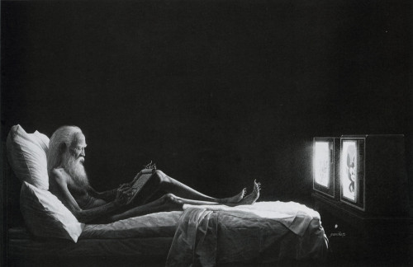
Howard Hughes (1905-1976)
Notes:
He spent most of his days living alone naked in his penthouse watching movies. He watched one movie 150 times!* "His reclusive activities (and possibly his drug use) made him practically unrecognizable; his hair, beard, fingernails, and toenails were long (possibly caused by [a disease] making him averse to touch), his tall 6 ft 4 in (193 cm) frame… weighed barely 90 pounds (41 kg)" (Wikipedia) and he had a fixation with Kleenex boxes that he kept everywhere to keep from collecting germs.
* He became obsessed with the 1968 film Ice Station Zebra and had it running on a continuous loop in his home. According to his aides, he watched it 150 times (Wikipedia)

Slide 51
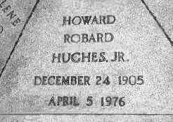
Howard Hughes
Notes:
"The FBI had to resort to fingerprints to identify the body… X-rays revealed five broken-off hypodermic needles in the flesh of his arms" (Wikipedia).

Slide 52
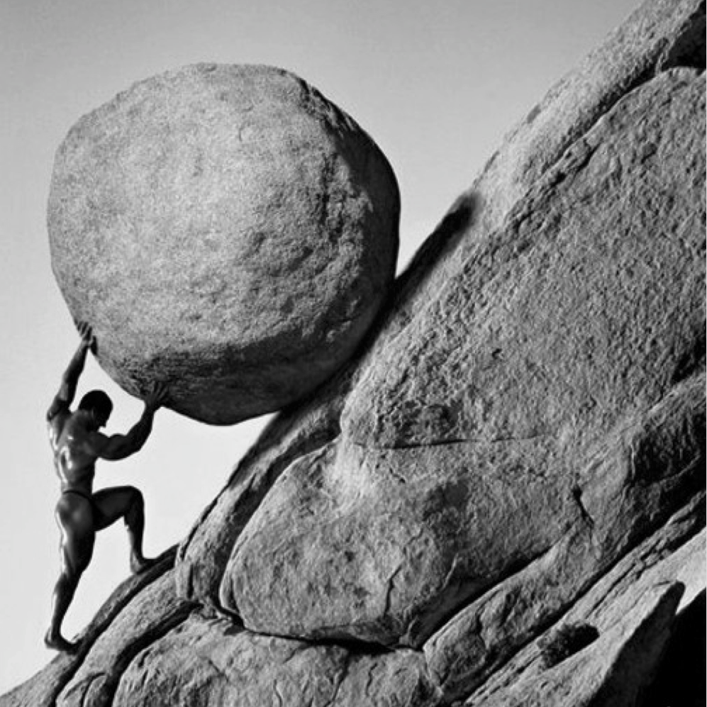
What are the profitless pursuits that we should avoid?
Ecclesiastes

Slide 53
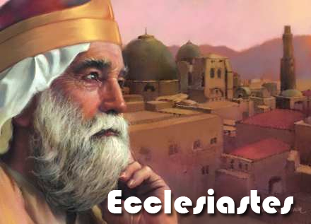
Solomon
"I, the Teacher, was king of Israel, and I lived in Jerusalem"
(1:12 NLT).
Ecclesiastes
Notes:
http://churchsermonseriesideas.com/?s=ecclesiastes image

Slide 54
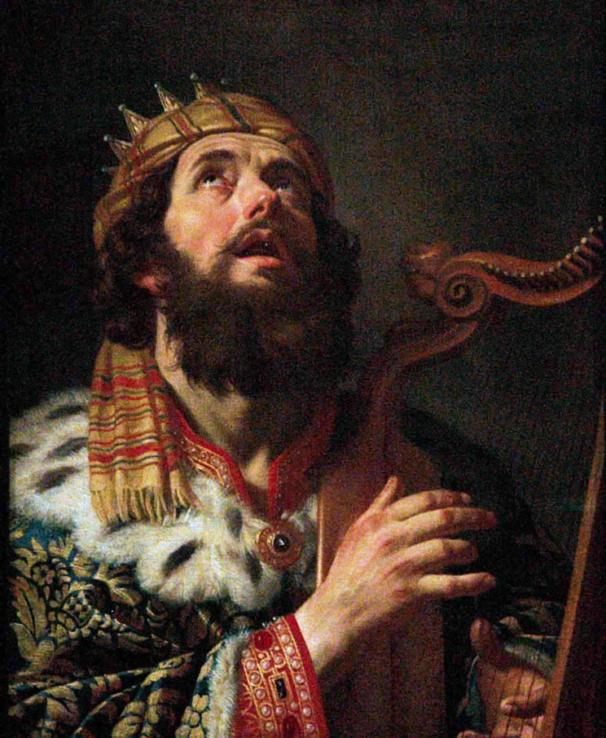
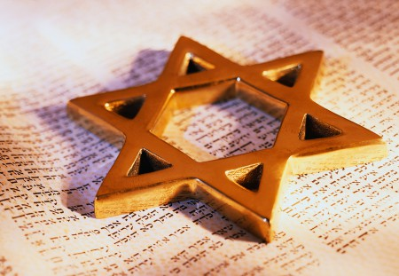
Israel's Golden Age

Slide 55
Fleeting
"I observed everything going on under the sun, and really, it is all meaningless—like chasing the wind"
(1:14 NLT).
Ecclesiastes
Notes:
http://churchsermonseriesideas.com/?s=ecclesiastes image

Slide 56

Cover
Let's see 5 of them…
Profitless Pursuits
Under the Sun

Slide 57
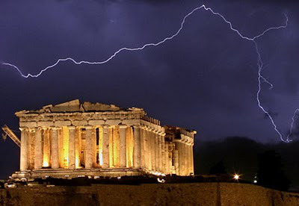
1. Prudence doesn't satisfy (1:16-18; 2:12-16).
Notes:
1:16—I said to myself, "Look, I am wiser than any of the kings who ruled in Jerusalem before me. I have greater wisdom and knowledge than any of them." ¹⁷ So I set out to learn everything from wisdom to madness and folly. But I learned firsthand that pursuing all this is like chasing the wind.
Eccl. 1:18 The greater my wisdom, the greater my grief.
To increase knowledge only increases sorrow.
Solomon's wisdom was unsurpassed by anyone of his time and perhaps by anyone in history (1:16; cf. 1 Kings 4:29-34).
His pursuit of wisdom (human intellect), madness (foolish ideas) and folly (pleasures) resulted in frustration (1:17).
Even when he achieved wisdom it was accompanied with mental grief and emotional pain (1:18).

Slide 58



2. Pleasure doesn't satisfy (2:1-3).
Notes:
Solomon tried pleasure in humor (2:2).
Solomon tried pleasure in wine (2:3a).
Solomon tried pleasure in foolishness (2:3b).

Slide 59
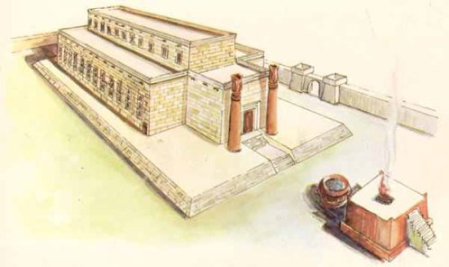
3. Projects don't satisfy (2:4-6).
Notes:
Solomon built homes for himself (2:4a; cf. 1 Kings 7:1-12).
Solomon planted vineyards for himself (2:4b; cf. Song 8:10, 11).
Solomon made gardens and parks for himself (2:5a).
Solomon had food production for himself (2:5b).
Solomon built irrigation ponds for himself (2:6; cf. Neh. 2:14; 3:15,16).

Slide 60
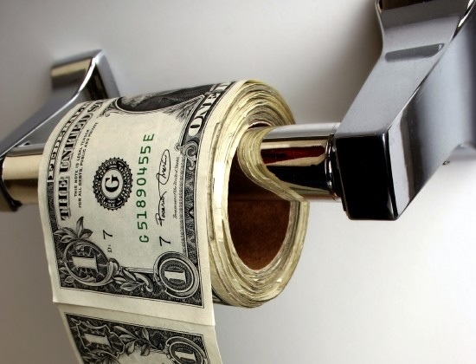
4. Possessions don't satisfy (2:7-8).
Notes:
Solomon had numerous servants/slaves (2:7a).
Solomon possessed more flocks and herds than anyone in Israel's history (2:7b).
Solomon had incalculable money for any material desire (2:8a; 1 Kings 10:14, 15, 27).
Solomon had musicians for his aesthetic desires (2:8b).
Solomon had a harem for his sexual desires (2:8c; cf. 1 Kings 11:1-8).

Slide 61

5. Power doesn't satisfy (2:9).
"So I became greater than all who had lived in Jerusalem before me, and my wisdom never failed me."

Slide 62
"Anything I wanted, I would take. I denied myself no pleasure. I even found great pleasure in hard work, a reward for all my labors. ¹¹ But as I looked at everything I had worked so hard to accomplish, it was all so meaningless—like chasing the wind. There was nothing really worthwhile anywhere."
Profitless Pursuits Conclusion (2:10-11 NLT)
Notes:
Solomon's conclusion is that all the preceding pursuits brought no ultimate satisfaction or lasting value (2:10-11).

Slide 63

Our pursuits never profit.
Main Idea of 1:12–2:16

Slide 64
Cover
Prudence
Pleasure
Projects
Possessions
Power
Profitless Pursuits
Under the Sun

Slide 65

What will it take for you to be really satisfied?
Notes:
We might say, "Well, if I just had more free time…"
You may be thinking, "A little more money might really help in the satisfaction department!"
Or, "Wow, if only so-and-so changed, I’d be happy!"

Slide 66

Since work is fleeting, trust God's timing, enjoy life, and enjoy God (2:17–6:9).
Notes:
Our to-do list at work never ends, so relax in God's plan. Trust his open doors and live with a sense of his blessing.

Slide 67
Slides on
Ecclesiastes 3

Slide 68

God's timing is perfect (3:1-8).
Notes:
He causes events at the flawless moment!

Slide 69
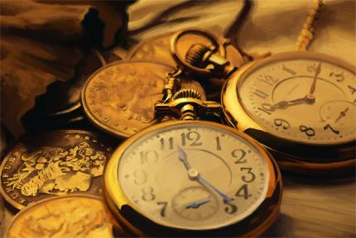
The Thesis: Every activity has its appointed time (3:1)

Slide 70

Ecclesiastes 3:1a (NIV)
"There is a time for everything…"

Slide 71

"…and a season for every activity under heaven" (3:1b NIV).
409

Slide 72

God's ways are perfect (3:9-11).
Notes:
Our best has limited success but God does everything right.

Slide 73

"What do people really get for all their hard work?" (3:9 NLT)

Slide 74

"I have seen the burden God has placed on us all" (3:10 NLT).
"I have seen the task which God has given the sons of men with which to occupy themselves" (3:10 NAU).

Slide 75

"Yet God has made everything beautiful* for its own time"
(3:11a NLT)
* "appropriate" (NAU), "fitting" (5:18)
Notes:
The Hebrew reads literally "beautiful" but the idea is more properly "appropriate" or "fitting"

Slide 76

Main Idea of Ecclesiastes 3
Celebrate your ignorance
of God's timing.

Slide 77

Key Ideas
God's timing is perfect (3:1-8).
God's ways are perfect (3:9-11).
Enjoy life and fear God (3:12-15).

Slide 78

What should you do when life is unfair?

Slide 79
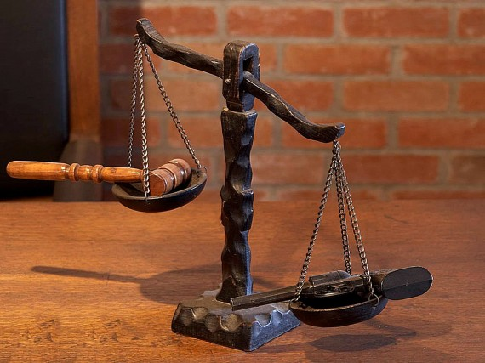
1. Realize that you will account to God (3:16-17).
Injustice
You

Slide 80

2. Enjoy life now (3:18-22)!
Death
Enjoy

Slide 81

Account to God and enjoy life!
Main Idea of 3:16-22
What should you do when life is unfair?

Slide 82
Slides on
Ecclesiastes 4

Slide 83

Workaholic Woes
Ecclesiastes 4
Dr. Rick Griffith, Crossroads International Church
BibleStudyDownloads.org

Slide 84

Why avoid being a workaholic?

Slide 85




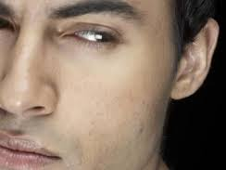
Workaholic Woes
No
Comforters
No
Rest
No
Followers
No
Beneficiaries
No
Friends
Notes:
No Comforters (4:1-3)
No Rest (4:4-6)
No Beneficiaries (4:7-8)
No Friends (4:9-12)
No Followers (4:13-16)

Slide 86

Main Idea of Ecclesiastes 4
Work at not becoming a workaholic.

Slide 87
Slides on
Ecclesiastes 5

Slide 88

How to Honor God
Ecclesiastes 5:1-7
Dr. Rick Griffith • Crossroads International Church Singapore
CICFamily.com • BibleStudyDownloads.org

Slide 89
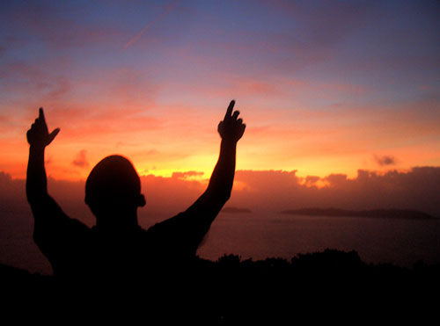
Do you struggle worshipping God?
Notes:
Obviously God is there when we attend church, and God is there when we approach Him in our own personal quiet time.
But unfortunately, we often don’t recognize His presence and sometimes we even end up in slumber land.

Slide 90
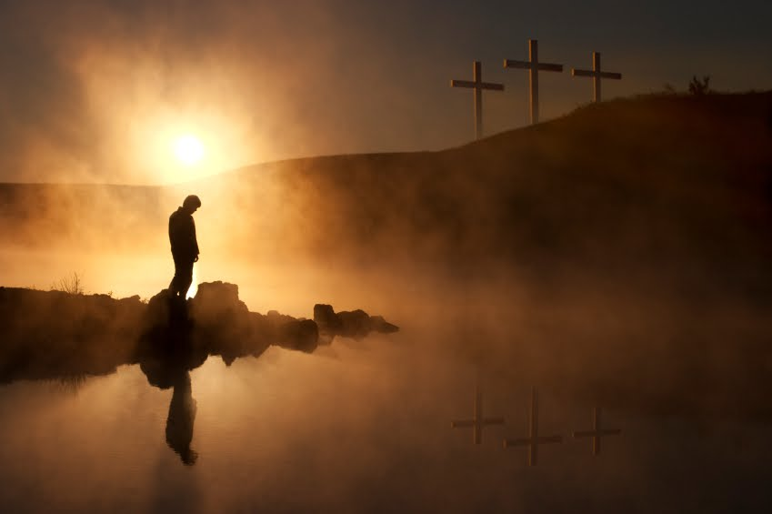
How can we honor God?
Notes:
What are the ingredients of a true reverence for God?

Slide 91

1. Honor God in your worship (5:1-3).
Notes:
We need to honor God by ascribing worth to Him in a way He accepts.

Slide 92

2. Honor God in your vows (5:4-7).
Notes:
If we truly respect the Lord in worship, we must keep our promises.

Slide 93

Main Idea of 5:1-7
Honor God in your worship and vows.

Slide 94
Slides on
Ecclesiastes 6

Slide 95
How can we do both?
enjoy life
fear God
Notes:
How can we be intentional to enjoy life and fear God?

Slide 96
I. Live as if life is fleeting
(1:1-11).
Notes:
Even the oldest people don't live very long.
Life's short-lived and fleeting cycles should move us to seek God.

Slide 97
II. Live as if work is fleeting
(1:12–6:9).
Notes:
Every human endeavor doesn't last very long.

Slide 98

III. Live as if wisdom is fleeting
(6:10–11:6).
Notes:
Even having the greatest discernment won't necessarily extend your life.

Slide 99
Ecclesiastes Overview
403
Notes:
But now the subject shifts into the third fleeting area in the book.

Slide 100
Slides on
Ecclesiastes 7

Slide 101

Man is ignorant so he must rely upon the immutable and wise plan of God (7:1–9:10).
Notes:
So why is this latter part of the book on wisdom in the Bible?
Some might think, “I agree. Life is more important than just work. What really makes life worthwhile is wisdom!” So now the topic shifts to addressing wisdom itself—but it will surprise you!

Slide 102

Signs of Real Wisdom
Ecclesiastes 7:15-29
Dr. Rick Griffith • Crossroads International Church Singapore
CICFamily.com • BibleStudyDownloads.org

Slide 103

Wisdom is Practical
"Biblical wisdom includes the art of being skillful and successful in one's relationships and responsibilities in life… An individual is 'successful' as he directs his life in accord with God's divine design, His plans for the world."
Roy B. Zuck, A Biblical Theology of the OT, 213

Slide 104

What are the qualities of wisdom?
3 characteristics
(Eccl. 7:15-29)
Notes:
In chapter 7, we are going to look at some characteristics of wisdom.
What are the qualities of wisdom?

Slide 105

1. Wisdom is balanced:
Avoid the extremes of depending on righteousness and living in sin (7:15-18).

Slide 106

2. Wisdom is strong:
Avoid the weakness from blindness to your own faults (7:19-22).

Slide 107

3. Wisdom is insightful:
Avoid thinking you have all the answers but still show insight (7:23-29).

Slide 108

Main Idea
Wisdom is balanced, strong,
and insightful.
Notes:
The Myth of the Balanced Life—Success Comes from Imbalance, not Balance
http://goaltriangle.com/advanced-goal-setting/the-myth-of-the-balanced-life-success-comes-from-imbalance-not-balance/
Is your life "balanced"?
If you are one of the rare people who would answer yes, then here's a follow-up question: how long have you been "balanced" and how long do you expect it to last?
We're told by psychologists, talk show hosts, life-coaches, and parents that we should be seeking "more balance".
From my experience, people who are spending their time seeking a "balanced" life fall into two categories:
a) People who have not accomplished anything remarkable, and never will, because they are constantly striving for "balance" (and are thus secretly afraid that doing what it takes to achieve true success in one area will put them out of balance).
b) People who have already achieved amazing things in one (or many) areas of their lives, and are now attending to the previously ignored aspects. Better term here would be people seeking to "rebalance".
These are two vastly different approaches to living. And I'll argue that the second is more admirable than the first. You see,
To accomplish truly great things, you need to seek an imbalanced life.
This imbalance I'm referring to is usually temporary. And the degree of imbalance depends on your specific goals.
But make no mistake, achievement of your most important, most ambitious goals, you need to embrace imbalance.
Let's start with a simple example, using the three corners of The Goal Triangle: family/relationships, fitness and health, and finances/career.
Imagine trying this coming month to "balance" these. If you are accustomed to goal setting, you will quickly come up with measureable, timebound goals for this month in each area. And you'll make some progress. But will you accomplish anything truly great, without having to "borrow" time, energy, or resources from another area?
For examples, here are three truly great (in terms of ambitious) goals for 30 days:
Fitness: Lose 10 pounds of fat without losing muscle.
Family: Spend extra time every day with your teenage kids (or working on strategies), beyond what you are already spending, resulting in 50% fewer arguments each week.
Finances: Perform so well in your job, through ingenuity or extra effort, that you could ask your boss in 30 days for a 5% raise and she would grant it.
Are these the "best" goals? Maybe not, but they are all examples of amazing accomplishments for a single month.
Could anyone achieve all of them at once? Not a chance. (Ok, maybe 1 out of 1000 people could; I know I couldn't. But later in this article I'll share how you can accomplish them all, just not in the same month.)
In fact, each one of these is so ambitious that I would argue accomplishing even one of them would be difficult.
And doing so – accomplishing just one of them – would require some sacrifices in the other areas of your Goal Triangle. If you dedicated yourself to fat loss, you'll need to exercise more, spend more time planning your menus, extra time doing research into food and calories, and possibly even extra time meditating to get through the emotional/mental struggle involved in losing so much fat without losing muscle!
The best-case result: your family and your work are simply "maintained" at their previous level of effectiveness. The worst case: less time and energy for your family and work, either of which hurts those corners of your Goal Triangle.
In other words, for that month, you will be imbalanced.
I'll repeat it again, knowing that I'm repeating myself: To accomplish truly great things, you need to seek an imbalanced life.
Does That Mean The Other Areas Must Suffer?
No, it doesn't mean that the other areas must suffer. Quite possibly, you can still accomplish small things. In the example above, while focused on losing the fat, you should still able to do your job at work. You'd still spend time with your kids. You may even make a little progress on small goals in each of those areas, but that depends on how deep you need to go into the main goal (in this case, fat-loss).
The more ambitious your goal (in terms of aggressive timelines or amazing results), the more likely other areas of your life could decline.
This is "temporary imbalance in the interest of achieving something truly great."
How Much Imbalance Is Too Much?
Depending on your main goal, you may be willing to go deep into imbalance or not so much. There is no single formula.
Stephen Covey talks about the "emotional bank account". The basic concept is that you are always either making deposits into or withdrawals out of your life's key areas. With work, you are either doing things to improve your skills, relationships, and performance or you are letting those things slip a bit. With your family, you are either building stronger relationships or you are straining them. Same with your fitness.
Taking relationships as a deeper example, you can miss one of your kids' basketball games (a withdrawal from the emotional bank account) if you've already been to the past three games (previous deposits into the emotional bank account). You can only withdraw what you've deposited. If you are taking more withdrawals than you've made deposits, then you are in trouble. Once an account balance is negative, it not only takes much more effort to restore good standing; you may also never recover.
I'm not advocating having a negative account balance in any area of your life. So you have to stay very aware of the impacts of your chosen imbalance. If you take the imbalance too deep or for too long, you obviously have to pull back.
So how does imbalance actually result in a greater life, full of diverse areas of achievement?
The Key To Balancing Imbalance
A simple but extremely effective way to avoid too much imbalance is this:
Cycle your imbalance.
Focus on one area, intentionally being imbalanced, for a period of time. Then switch gears to a different area, while simply maintaining the gains you made in the first area.
Over time, you are actually achieving life-long balance, even though there is never a single point in time where you are balanced. Think of it as a helix, where you are cycling around but over time climbing higher and higher because you are periodically rebalancing your life.
How Often To "Rebalance"?
I like to think of most big things in longer blocks than a month. Three months works pretty well for most ambitious objectives, because it's enough time to accomplish truly great things but short enough that less attention to the other areas won't do too much damage. This gives you 4 really ambitious goals to accomplish each year.
But some goals may require longer periods of imbalance. If you've been a horrible dad for 10 years and suddenly want to be a great dad, you are going to need to make that your primary focus for much longer than 3 months, even if that means you make little to no progress on career and fitness.
And some goals could take shorter than 3 months. For example, quitting smoking.
You're not looking for a balanced life, you're looking to constantly shift your balance one way then another.
And the magic of this is that once you achieve an ambitious goal, it usually is long lasting with reduced effort. You focus on learning the basics of a certain language, and then maintaining your fluency is easier than the initial learning. You focus for a few months really hard on learning everything about the right way to eat, even to the point where other parts of your life become secondary, but then you have that knowledge. It doesn't go away. It's like an investment.
What Goals Are Worth Being Imbalanced Over?
When you're setting a goal that feels really ambitious, ask "Is this goal really important enough to me that I'm willing to be imbalanced as I pursue it? Am I willing to somewhat neglect other areas of my life to achieve it?"
If it is truly a great, ambitious goal, then you should feel some butterflies in your stomach as you ask those questions. Achieving great things doesn't come easily. If you don't feel butterflies, then maybe it's not ambitious enough to earn the description of "truly great".
Perhaps there's a better big, ambitious goal to pursue. One whose achievement is worth being "temporarily imbalanced".

Slide 109
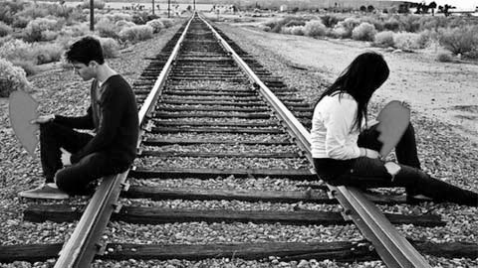
Questions
Balance: Is wisdom guarding me from extremes?
Strength: Is wisdom keeping me stable?
Insight: Is wisdom clearing my mind to see reality?
(Swindoll, Living on the Ragged Edge Study Guide, 73).
Notes:
We can't have Christ's wisdom without first having Christ. Do you know him?
In what area of your life do you need balance, strength, or insight? Identify it and ask God's wisdom and courage to put this wisdom to work!

Slide 110
Slides on
Ecclesiastes 8

Slide 111
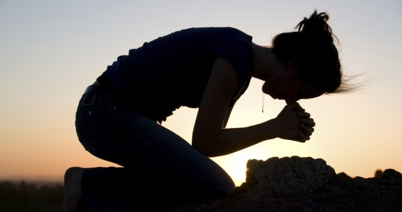
Submission & Joy
Ecclesiastes 8
Dr. Rick Griffith • Crossroads International Church Singapore
CICFamily.com • BibleStudyDownloads.org

Slide 112

How should we respond to authority
—to both God and man?

Slide 113

1. Obey authorities due to the many advantages (8:1-9).

Slide 114
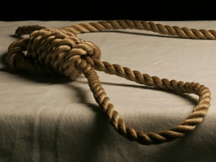
2. We punish the wrong people
—so it puzzles us (8:10-14).

Slide 115

Who do we punish?
We don't punish bad people
(8:10-13).
We punish good people instead
(8:14).

Slide 116

3. Enjoy life and submit to God even though He won't tell us His reasons (8:15-17).

Slide 117
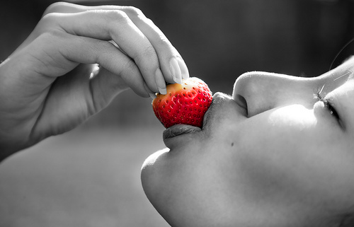
"So I recommend having fun, because there is nothing better for people in this world than to eat, drink, and enjoy life."
"That way they will experience some happiness along with all the hard work God gives them under the sun" (8:15 NLT).

Slide 118

Humbly submit to man and God—and you'll get joy!
Main Idea of Ecclesiastes 8

Slide 119

Where do you need to…
• Submit to authority?
• Recognize your limited understanding?

Slide 120
Slides on
Ecclesiastes 9

Slide 121

The Future
UNCERTAIN
Website

Slide 122
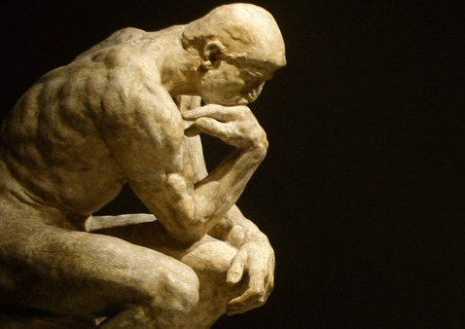
How do most people deal with our uncertain future?
Materialism
Hedonism
Humanism
Fatalism

Slide 123

How should we respond to an uncertain future?
Ecclesiastes 9:1-10
Our Reality
(1-6)
Our Response
(7-10)
Notes:
Transition: Solomon first tells us the reality that we all face...

Slide 124

1. Your uncertain future includes certain death (9:1-6).
Notes:
You know nothing of what will happen to you except that you will die!

Slide 125
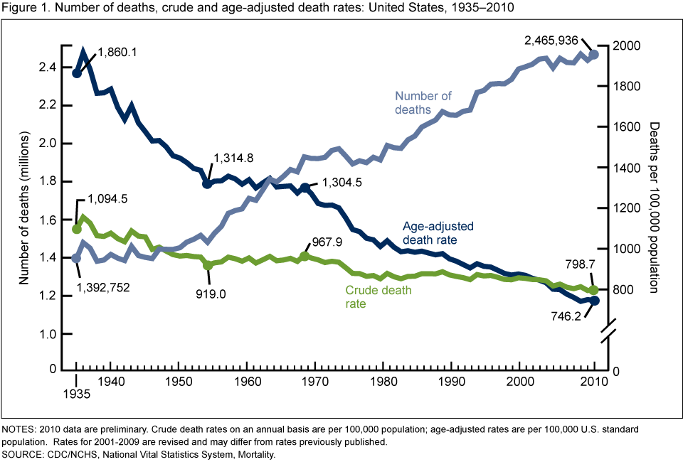
75 Years of Mortality in the United States, 1935–2010
Centers for Disease Control and Prevention (cdc.gov)
Notes:
Is the death rate goinng up or going down?
____________
Although the number of deaths increased over the 75 years, the risk of dying decreased
NCHS Data Brief
Number 88, March 2012
Donna L. Hoyert, Ph.D.
http://www.cdc.gov/nchs/data/databriefs/db88.htm

Slide 126
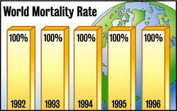
Death Rate 1992-1996
World Mortality Rate
Notes:
The Onion: America's Finest News Source, reports…
GENEVA, SWITZERLAND—World Health Organization officials expressed disappointment Monday at the group's finding that, despite the enormous efforts of doctors, rescue workers and other medical professionals worldwide, the global death rate remains constant at 100 percent.
Death, a metabolic affliction causing total shutdown of all life functions, has long been considered humanity's number one health concern. Responsible for 100 percent of all recorded fatalities worldwide, the condition has no cure.
"I was really hoping, what with all those new radiology treatments, rescue helicopters, aerobics TV shows and what have you, that we might at least make a dent in it this year," WHO Director General Dr. Gernst Bladt said. "Unfortunately, it would appear that the death rate remains constant and total, as it has inviolably since the dawn of time."
News • survival • ISSUE 31•02 • Jan 22, 1997
http://www.theonion.com/articles/world-death-rate-holding-steady-at-100-percent,1670/

Slide 127

2. Since you'll die, enjoy life and work hard now (9:7-10).

Slide 128

"So go ahead. Eat your food with joy, and drink your wine with a happy heart, for God approves of this!" (9:7 NLT).
Notes:
Enjoy life as God enables (9:7-9).

Slide 129

Main Idea of Ecclesiastes 9:1-10
Since you don't know the future, work hard and enjoy life!

Slide 130
Slides on
Ecclesiastes 10

Slide 131

Why doesn't wisdom always lead to success?

Slide 132

1. Life is unfair (9:11–10:7).
Notes:
The inequities of life afflict the wise as well as the rest of us!
Our existence does not have all accounts settled fairly yet.
Wisdom recognizes this truth that humanity is biased and inequitable.

Slide 133

2. Life is uncertain (10:8-11).
Notes:
The unreliable nature of life hinders wisdom.

Slide 134

Don't trust wisdom—trust God!

Slide 135
FOOLS.
Notes:
Today I will speak on something I do not recall ever hearing a message about!
• Fools! We all have to deal with fools.

Slide 136

FOOLS
We all know one.

Slide 137

FOOLS
We've all been one.
Notes:
I've been a fool this very week!
So I can speak with experience!

Slide 138
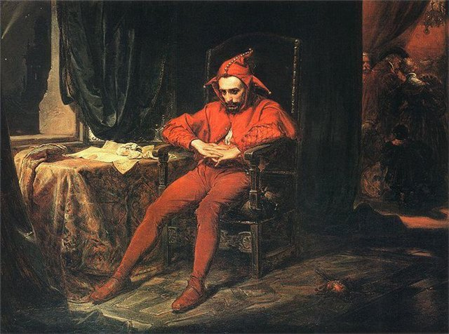
How should we deal with a fool?
Notes:
We all need to know how to deal with fools. There are plenty of them around.
My challenge in addressing this passage relevantly is to talk about fools without being foolish myself. How specific should I be? What one person thinks is a fool, another person considers a hero.

Slide 139
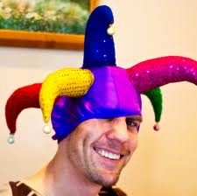
1. Description: The speech and actions of a fool are destructive (10:12-19).
Notes:
Fools both speak and act in a way that ruins.

Slide 140

2. Warning: Don't even privately criticize foolish authorities because they may find out (10:20).
Notes:
Watch your tongue concerning your boss—or it might bite you.

Slide 141

Don't criticize your foolish leader (Main Idea of 10:12-20)
Notes:
When it comes to the superior with whom you disagree…
Keep your thoughts to yourself!

Slide 142

Have you criticized a superior?
"It takes little size to criticize."
Notes:
Have you been critical of your church leaders, even in private?
Do you join the company gossip about your boss?
How quickly do you judge the decisions of your PM, president, judges, government officials, or other leader?

Slide 143
Slides on
Ecclesiastes 11

Slide 144

How does the uncertainty of the future affect you?
• Giving? • Investments? • Work?
Notes:
How does an uncertain future influence your giving?
How does an uncertain future influence your investments?
How does an uncertain future influence your work?

Slide 145
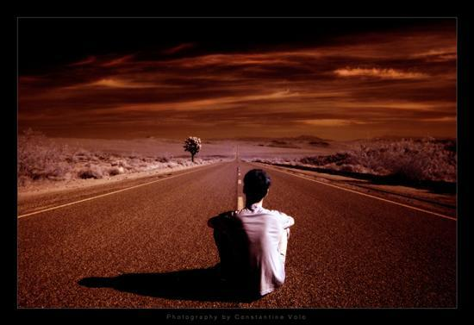
How should your uncertain future influence you?

Slide 146

1. Give generously and invest wisely (11:1-3).
Notes:
Hold money loosely but discerningly since you don't know the future

Slide 147

"Cast your bread upon the waters, for after many days you will find it again"
(11:1 NIV).
"Send your grain across the seas, and in time, profits will flow back to you"
(11:1 NLT).
Notes:
“Cast your bread upon the waters,” says the NIV. And what will you get? Soggy bread?
What’s the point?
Give generously, for your gifts will return to you later (11:1)
The NLT sees this exclusively referring to business profits [read NLT]
However, can’t it also refer to giving?

Slide 148
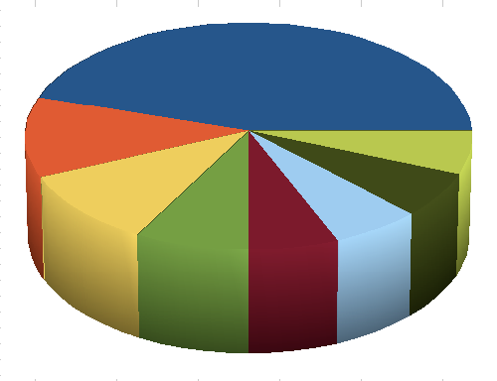
"But divide your investments among many places, for you do not know what risks might lie ahead" (11:2 NLT).
Notes:
Don't hoard, but give and invest since you don't know the future (11:2).

Slide 149

2. Work hard due to your uncertain future (11:4-6).
Notes:
Don’t let your ignorance of the days to come lead to apathy.

Slide 150

Give generously, invest wisely and work hard since you don't know your future.
Main Idea of 11:1-6
Notes:
Ignorance of the future should give us wisdom about money and work (MI restated).

Slide 151
How can we do both?
enjoy life
fear God
Notes:
How can we be intentional to enjoy life and fear God?

Slide 152
I. Live as if life is fleeting (1:1-11).
Notes:
Even the oldest people don't live very long.
Life's short-lived and fleeting cycles should move us to seek God.

Slide 153
II. Live as if work is fleeting
(1:12–6:9).
Notes:
Every human endeavor doesn't last very long.

Slide 154
III. Live as if wisdom is fleeting
(6:10–11:6).
Notes:
Even having the greatest discernment won't necessarily extend your life.

Slide 155

IV. Live as if youth is fleeting
(11:7–12:14)
Notes:
Young people aren't young for very much of their lives.

Slide 156
Ecclesiastes Overview
403
Notes:
But now the subject shifts into the fourth fleeting area in the final section of the book.
This time it’s about youth (explain book chart).

Slide 157

How to Enjoy Your Youth
Ecclesiastes 11:7–12:7
Dr. Rick Griffith, Crossroads International Church
BibleStudyDownloads.org
Notes:
Today we see how to enjoy your youth.

Slide 158


Are you a youth?
Notes:
But are you a youth? How would you know?

Slide 159
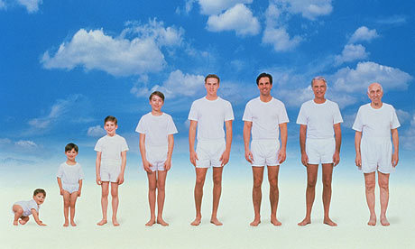
What are the stages of life?
Notes:
Are you a youth or not? That depends on how many stages of life exist. But in its most basic sense, I think life has essentially three stages…

Slide 160

Three Stages for Women
1. Annoying her dad
2. Annoying her husband
3. Annoying her son-in-law
Notes:
One person says that the three stages for women include: (1) annoying her dad, (2) annoying her husband, and (3) annoying her son-in-law.
What a sad evaluation that is!

Slide 161
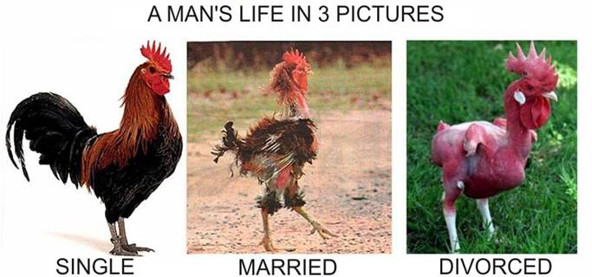
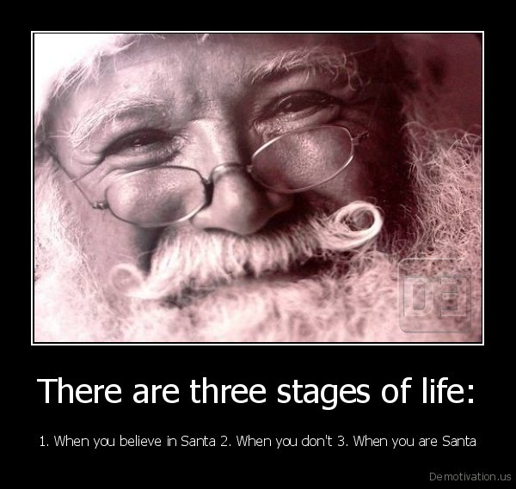
Three Stages for Men
1. You believe in Santa 2. You don't believe 3. You are Santa
Notes:
For men the stages are: (1) You believe in Santa, (2) You don't believe, and (3) You are Santa!
Seriously speaking, though…

Slide 162

Life has three stages
What should youth pursue in life?
Youth
0-30
Youth
0-30
Mid-Life
30-60
Elderly
60-90
Notes:
Youth includes birth up to about age 30, since by that time most of us get married and are on our own.
Mid-life starts quite early in this depiction at age 30 and goes to age 60.
Nowadays many people live into their 80s and even their 90s, so old age would refer to ages 60-90.
What happens in stage 1 will certainly influence stages 2 and 3, so youth is crucial. This raises the important question: What should youth pursue in life? How should they live>

Slide 163

Life has three stages
What should youth pursue in life?
Focus
on 2 pursuits
Youth
0-30
Youth
0-30
Eccl. 11:7
–12:7
Notes:
This passage specifically shows two pursuits every youth should have. However, it actually relates to all of us, whether youth or not. Even if you are not a youth, you certainly relate to youth and can help them with this passage. This means that you are closer to aging, which this passage also addresses!
Solomon gives us God’s two key priorities for youth in Ecclesiastes 11:7–12:7. Let’s listen in!

Slide 164

1. Enjoy life now before judgment and death comes (11:7-10).
Notes:
Live each day with joy because you’ll account for it and it might be your last.

Slide 165

2. Honor God as Creator before you grow old and die (12:1-7).
Notes:
Respect the Lord as a young person because you soon will be elderly.

Slide 166
Slides on
Ecclesiastes 12

Slide 167

"Don't let the excitement of youth cause you to forget your Creator. Honor him in your youth before you grow old and say, 'Life is not pleasant anymore'"
(12:1 NLT).
"Remember also your Creator in the days of your youth…" (12:1 NAU).
Notes:
Honor your Creator now.

Slide 168
1. The Theme: Life is fleeting (12:8).
"Everything is meaningless,"
says the Teacher,
"completely meaningless."
Key Word of Ecclesiastes
Notes:
Sounds dismal, doesn't it? Maybe you're saying, "Can't you offer anything more positive than this today? If life is so short then what value is there in listening to Solomon—or you, for that matter?" Good question. Actually, I have nothing of value to say today except what God says, and He says in verses 9-12 that his word is…

Slide 169

2. The Authority: Live by God's words (12:9-12).

Slide 170

God's words matter!
78
^{"9}Not only was the Teacher wise, but also he imparted knowledge to the people. He pondered and searched out and set in order many proverbs. ¹⁰The Teacher searched to find just the right words, and what he wrote was upright and true" (Eccl. 12:9-10 NIV).
Notes:
Solomon put his wisdom to work by teaching (12:9-10).
Solomon was a wise man who taught others knowledge (12:9a).
Solomon taught with proverbs (12:9b-d).
Some proverbs he thought up himself (12:9b).
Some proverbs he got from others (12:9c).
Some proverbs he arranged together [in the book of Proverbs?] (12:9d).
Solomon taught with the best words (12:10).
He used words that were aesthetically pleasing (12:10a).
He wrote with precision to guard the truth (12:10b).

Slide 171

The Bible's Wisdom
78
^{"11}The words of the wise are like goads, their collected sayings like firmly embedded nails—given by one Shepherd. ¹²Be warned, my son, of anything in addition to them."
(Eccl. 12:11-12a NIV).
Notes:
In contrast, man's books provide no ultimate answers and wear us out (12:12).
Don't rely on books other than words of the wise (12:12a).

Slide 172

"Of making many books there is no end…"
(Eccl. 12:12b NIV)
Notes:
Man's many books still have not answered our most vital questions (12:12b).

Slide 173

"…and much study wears you out"
(12:12c NLT).

Slide 174

3. The Conclusion: Respect and obey God because this applies to everyone
(12:13-14 ).
Notes:
Live in awe of God and do what He says so that you'll always be doing the right thing.

Slide 175

"That's the whole story.
Here now is my final conclusion:
Fear God and obey his commands"
(12:13a-b NLT).
But why?
Notes:
You'll succeed when you respect God's person (13a).
Fearing Him means living aware of his awesome love for you!
You'll also succeed when you follow God's standards (13b). Do what He says!
Realize that he gives us commands to live by because he has your best interest in mind

Slide 176
"That's the whole story. Here now is my final conclusion: Fear God and obey his commands, for this is everyone's duty"
(12:13 NLT).
Notes:
Respecting and obeying God is the main task for which we'll be accountable (13c-14).
Respect and obey God as it ensures you'll do everything else that's important (13c).

Slide 177

Said differently...
Respect and obey God
to finish well.

Slide 178
How can we do both?
enjoy life
fear God
Notes:
How can we be intentional to enjoy life and fear God?

Slide 179
Main Idea:
Be intentional to live as if life is fleeting—including work, wisdom and youth.
Notes:
Since life is brief, make the most of it by living for your Creator—then you will be truly happy!

Slide 180
I. Live as if life is fleeting
(1:1-11).
Notes:
Even the oldest people don't live very long.
Life's short-lived and fleeting cycles should move us to seek God.

Slide 181
II. Live as if work is fleeting
(1:12–6:9).
Notes:
Every human endeavor doesn't last very long.

Slide 182
III. Live as if wisdom is fleeting
(6:10–11:6).
Notes:
Even having the greatest discernment won't necessarily extend your life.

Slide 183
IV. Live as if youth is fleeting
(11:7–12:14)
Notes:
Young people aren't young for very much of their lives.

Slide 184
"That's the whole story.
Here now is my final conclusion:
Fear God and obey his commands"
(12:13a-b NLT).
But how?
Notes:
Before I asked WHY we should fear and obey God.
Now I ask HOW we can do it.
Well, it comes down to…

Slide 185

Your Pursuit?
Notes:
What is your greatest pursuit in life? What are you intentional about?
Each of us is intential. The question is what we are intentional about.
Where do you run? What's your passion?
Wisdom? Wine? Work? Women? Wealth?

Slide 186

Bible Reading Plans
Do you hunger for God's Word?
Notes:
You may need to read other books more than this Book, but may I encourage you to read this Book first? Make it your daily passion to get God's view on life before you get any other!

Slide 187

Bible Reading Plans
5 min./day = 1/288th of a day
bible-reading.com
Notes:
Are you willing to tell God even right now that you'll read this Book at least 5 minutes daily—for the rest of your life?
In 1977 I committed to reading the Bible at least 5 minutes a day—but that's only 1/12th of an hour and 1/288th of a day! Not really a big decision…
If you won't make a commitment even this small, then I can offer little hope that you will be successful in what really counts in life.
But if you will commit to allow His words to change you daily, you will be making one of the best decisions possible.

Slide 188
Black

Slide 189


OT Preaching link at BibleStudyDownloads.org
Get this presentation and script for free!

